Slide 1
TRACING RAW MATERIALS THROUGH THE SUPPLY CHAIN: FOOD PROCESING COMPANY
U2SID Erasmus + Digital Challenge at University "Luigj Gurakuqi" of Shkodra
Team
Students: Gentiana Prendi (Finance), Klea Qallija (Business), Arbi Gjylbegaj (Informatics), Orkid Barbullushi (Informatics)
Academics: Erjola Barbullushi, Ermira Kalaj, Arjeta Anamali
IT support: Noel Radovani

Slide 2
Outline :
Executive summary of the project team
Company's profile
Objectives of the project team
Methodology and data collection
Solution proposal

Slide 3
Executive Summary
This study focuses on enhancing the traceability of raw materials within a local food processing company.
The goal was to design a traceability system that complies with national and EU food safety standards while improving operational efficiency and customer trust.

Slide 4
Company Profile
The company was founded in 2002 in Shkoder;
-6 mobile commercial units
-2 shops, and two warehouses in Shkoder and Tirana
-19 employees
-30 products
-Geographical distribution area reaches 17 cities

Slide 5
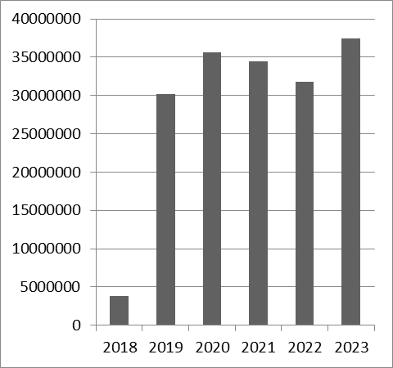
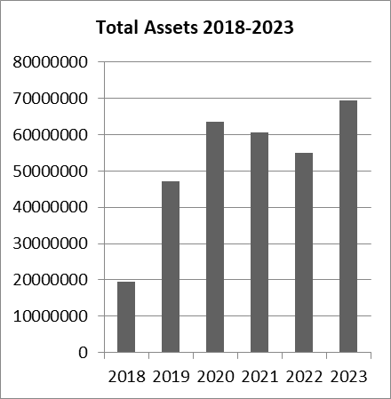
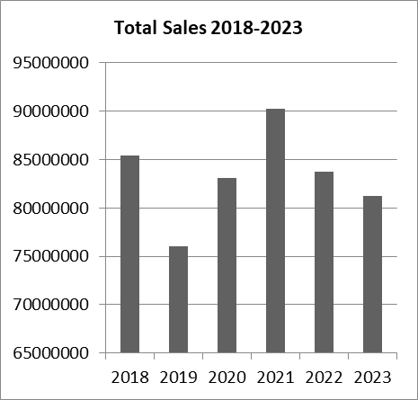
Company Profile through years

Slide 6
Objectives
- Strengthen product recall management
- Ensure compliance with food safety laws
- Improve inventory management
- Increase customer trust through transparency

Slide 7
Methodology Overview
A mixed-methods approach was used, combining qualitative and quantitative data.
- Structured interviews
- Direct observations
- Review of internal documents
- System Development Life Cycle (SDLC) methodology

Slide 8
Data Collection Methods
- Interviews with production, logistics, and IT staff
- On-site observations of production processes
- Analysis of technological cards and invoices
- Review of Albanian and EU food safety regulations

Slide 9
System Development Life Cycle (SDLC)
1. Requirement Gathering
2. System Architecture Design
3. Database Structuring
4. Implementation
5. Testing and Validation

Slide 10
Key Findings
- Significant investments in infrastructure (2018-2023)
- Inefficiencies in product tracking and data integration
- Reliance on manual data entry processes
- Lack of comprehensive traceability from production to sales
- Potential compliance risks with food safety standards
- Challenges in managing product recalls effectively

Slide 11
Excel WorkBook Integration
First solution - Implemented

Slide 12
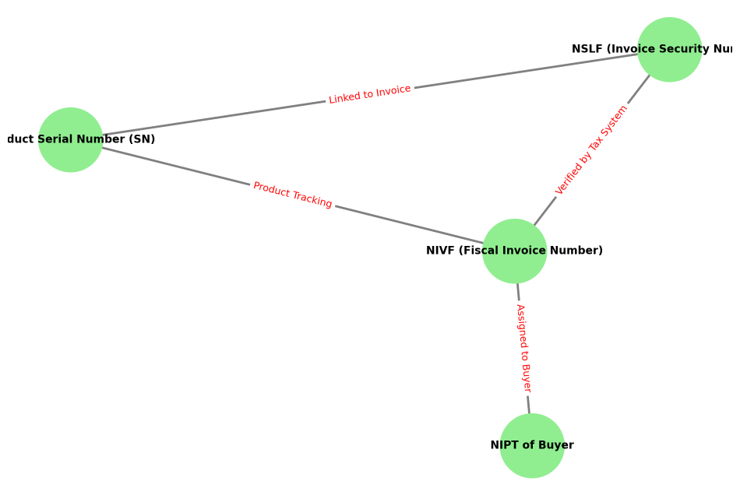
Software development:
Traceability System for Lot Numbers: From Production to Sales
Figure 1. Link between PSN, NSLF, NIVF, NIPT
a) Lot Number Generation
Each product batch must be assigned a unique lot number at the time of production cited as Product Derial Number (PSN). Format Example:
YYMMDD-PRODUCTCODE-SEQ (Example: 240204-MP-001 → February 4, 2025, Meat Product Name, Batch 001)
b) Data Captured Per Lot
Raw material source (supplier, date of delivery)
Production date & time
Processing equipment used in case different equipments are used in processing different products
Quality control results
Storage & packaging
c) Labeling & Scanning
Each packaged product must have a barcode or QR code with the lot number.

Slide 13
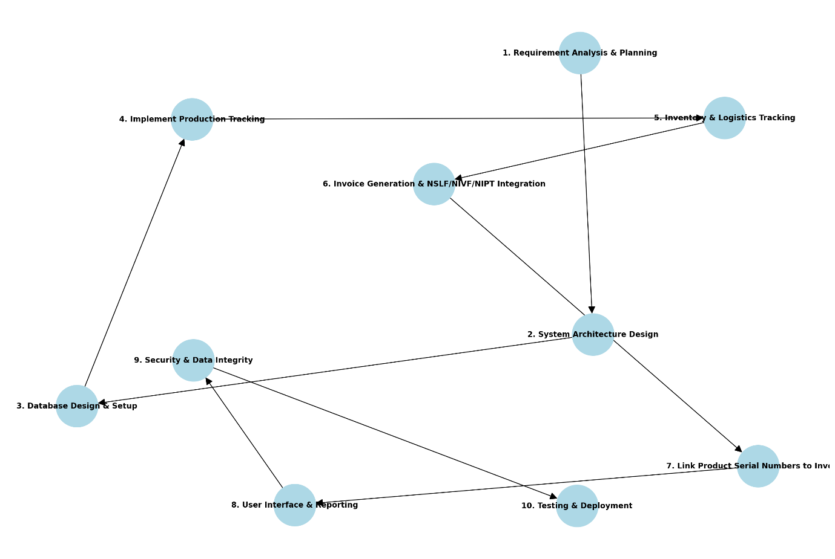
Table 1- Technological Card- Beef Sausages
INGREDIENTS | 100 KG | BATCH (LOT)
SALT | 1.8 | 28.08.2025
SPICE 1 | 0.3 | 16.05.2025
SPICE 2 | 0.25 | L:0005674940002
SPICE F | 0.73 | L 01.04.2026
AROMA 1 | 0.06 | L24DFBD 09/2026
COLOR | 0.011 | 28.06.2027
STARCH | 3 | LNP4D504 04/01/2027
MEAT MINCE | 50 | L4268813491
WATER | 15 | -
BEEF MEAT | 14 | L78915150477136600

Slide 14
System Features
Benefits of the System
- Real-time tracking of product batches
- Historical data storage and retrieval
- User-friendly interface for staff
- Enhanced regulatory compliance
- Improved operational efficiency
- Increased customer trust and transparency
- Streamlined product recall processes

Slide 15
Regulatory Compliance
Implementation Challenges
- Albanian food safety laws
- EU food safety regulations
- Compliance with HACCP principles
- Integration with tax authority systems for invoicing
- Development time and resource allocation
- Staff training and adaptation to new processes
- Ensuring data security and integrity
Project Timeline
1. Requirement Analysis – Month 2-3
2. System Design – Month 4-7
3. Development and Testing – Month 8-14
4. Deployment and Training – Month 15-17
5. Full Implementation – Month 18-22

Slide 16
Expected Outcomes
- Fully integrated traceability system
- Improved food safety compliance
- Streamlined operations and inventory management
- Increased transparency and customer satisfaction

Slide 17
Thank you for your attention!
Q&A

