Slide 1
U2SID PROJECT
University of Montenegro
Team 2

Slide 2
Challenge
How to encourage young people to actively participate in cultural and sports events?
Stakeholder: Secretariat for culture, sports, youth and social welfare – Municipality of Nikšić

Slide 3
Challenge
Young people do not attend cultural and sports events frequently, citing insufficient information as the main reason. The key was to design a digital, creative, and easily accessible solution that would provide young people with simple access to event information. This lack of interest could negatively affect their proper development and social inclusion. The goal was to develop a digital platform that would increase awareness, motivate young people to participate, and thereby boost attendance at cultural and sports events.

Slide 4
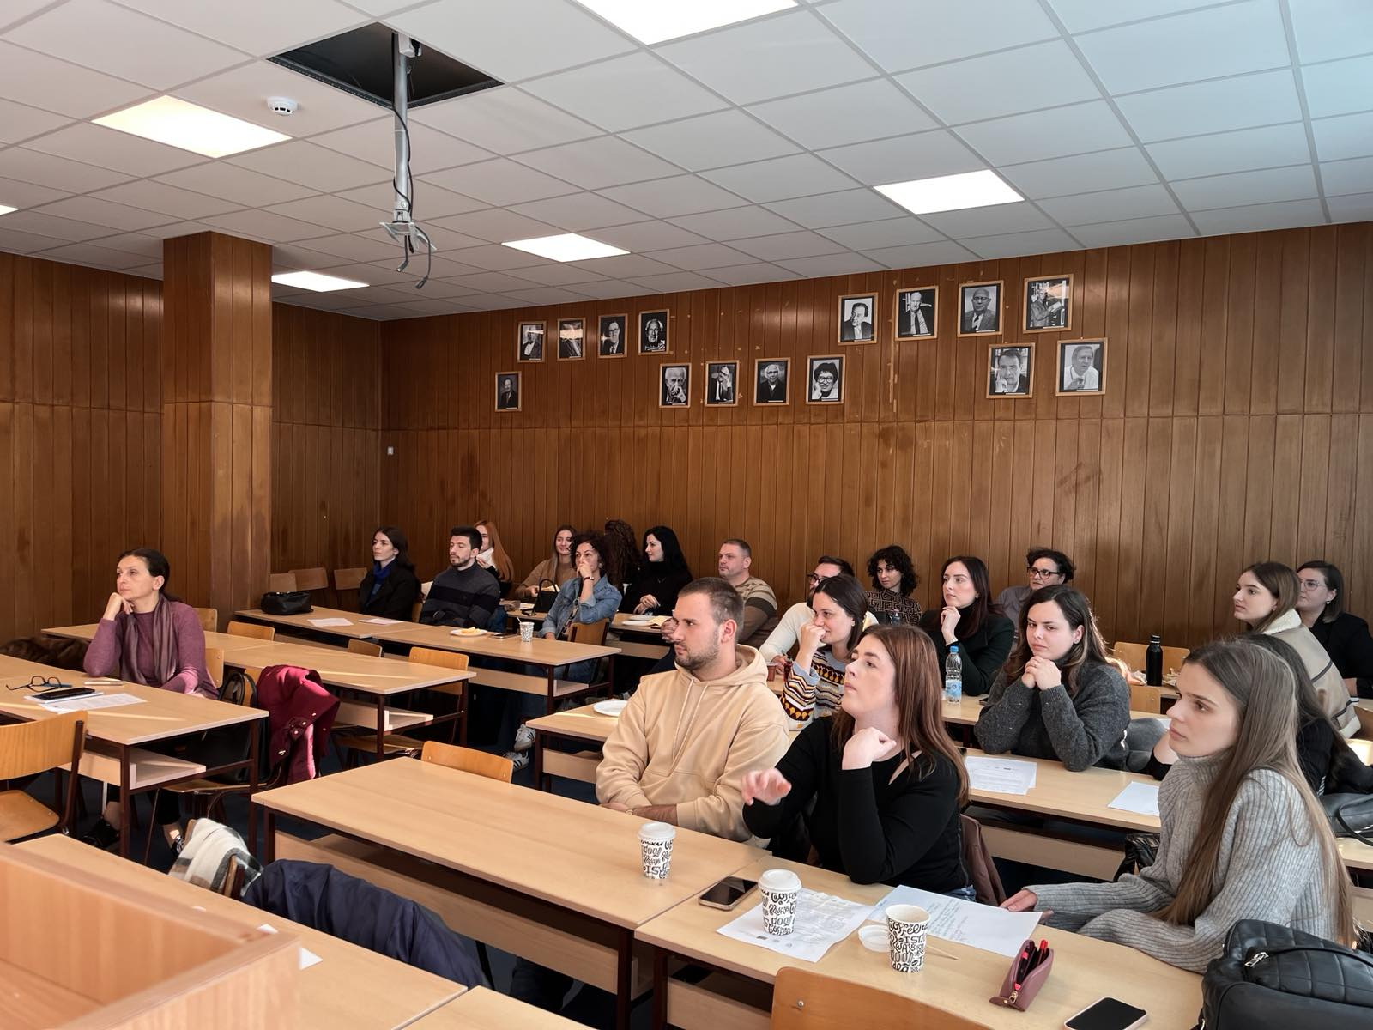
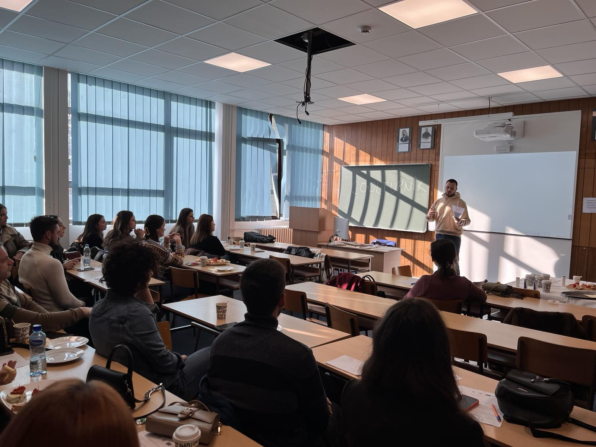
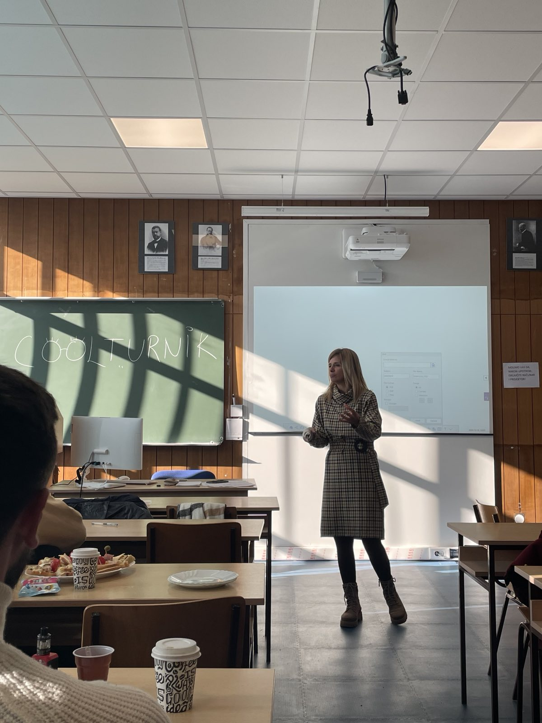
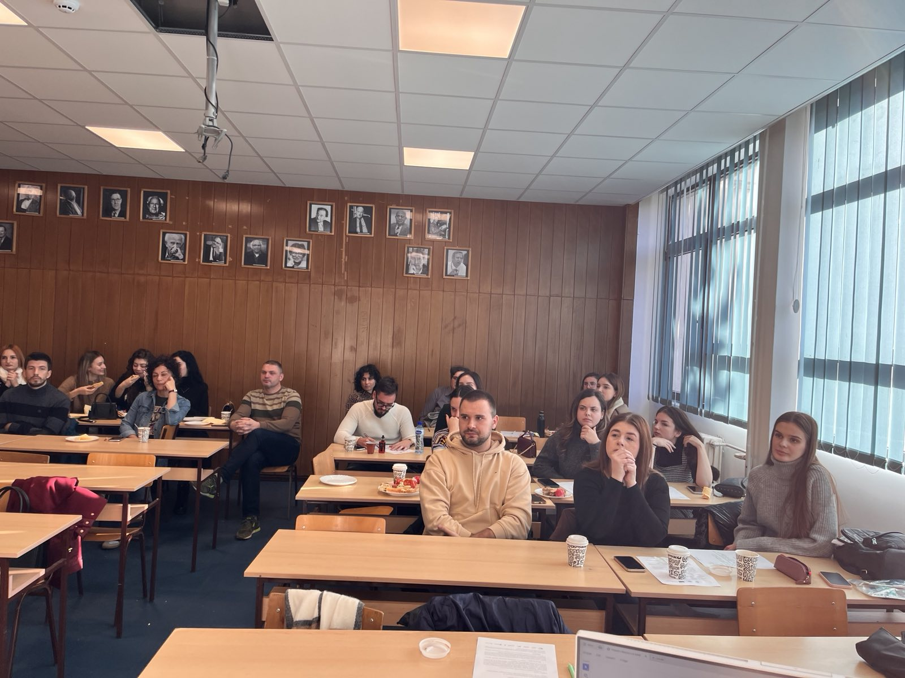
Team 2 – brainstorm meeting

Slide 5
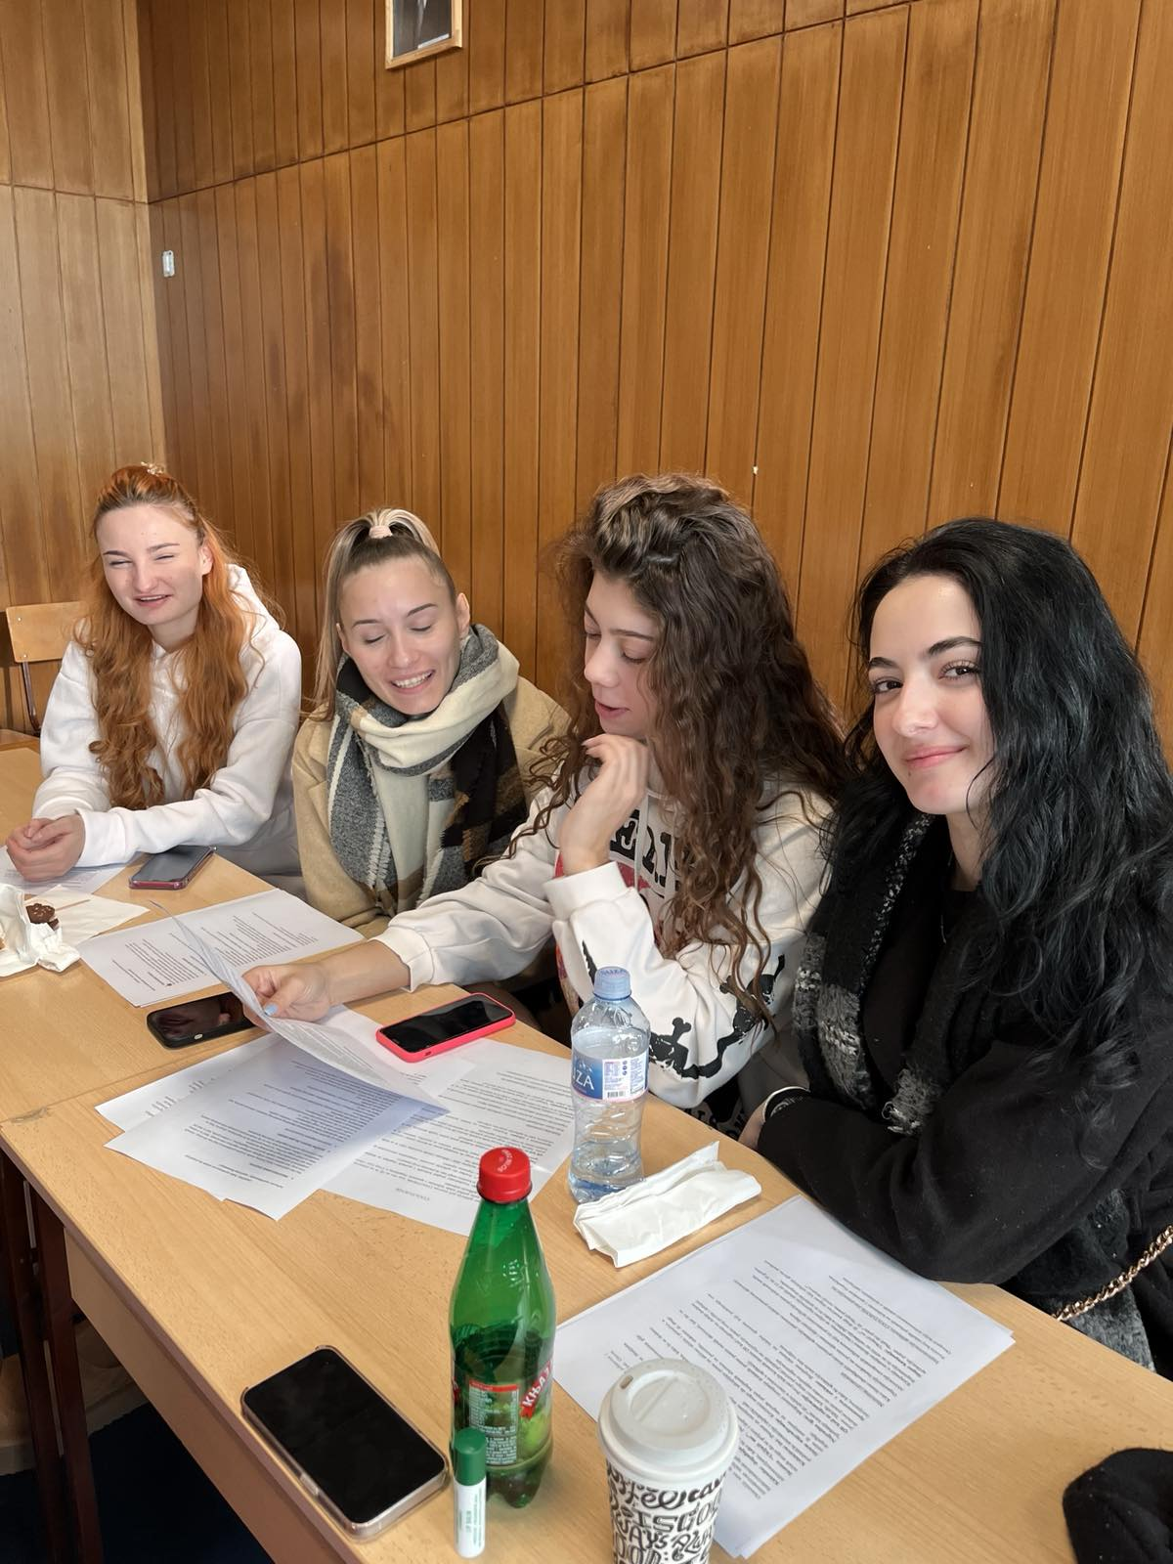
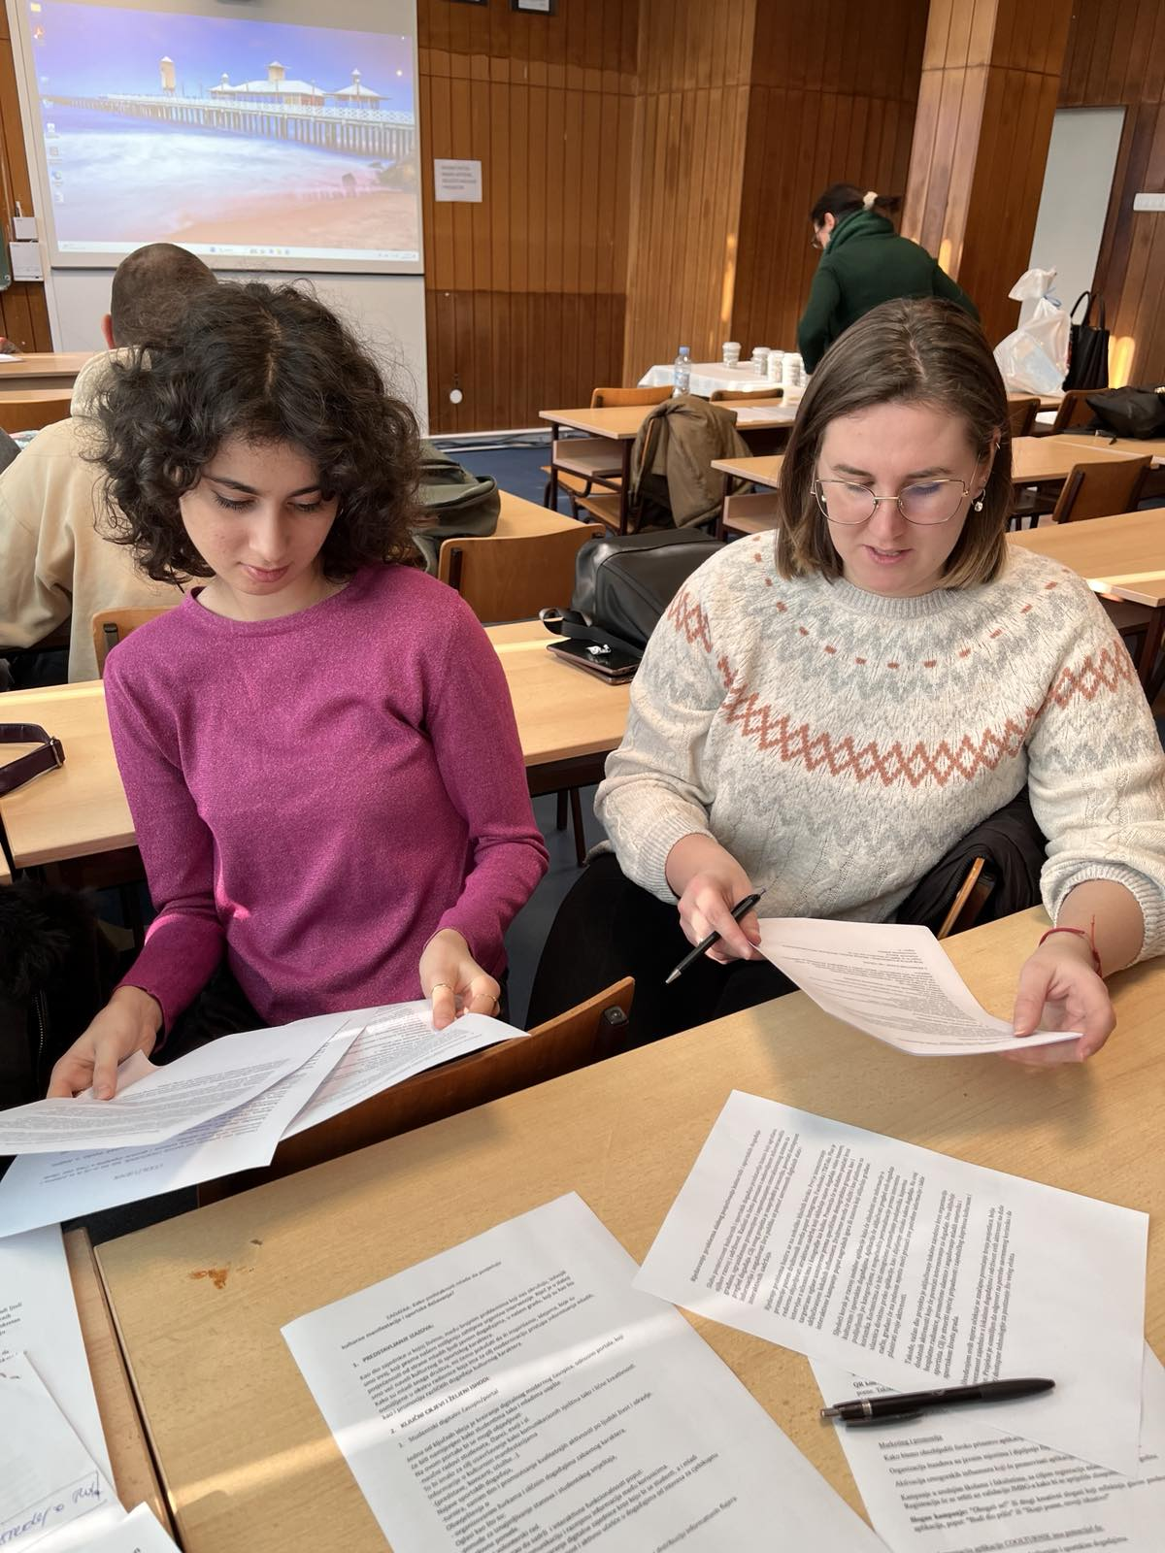
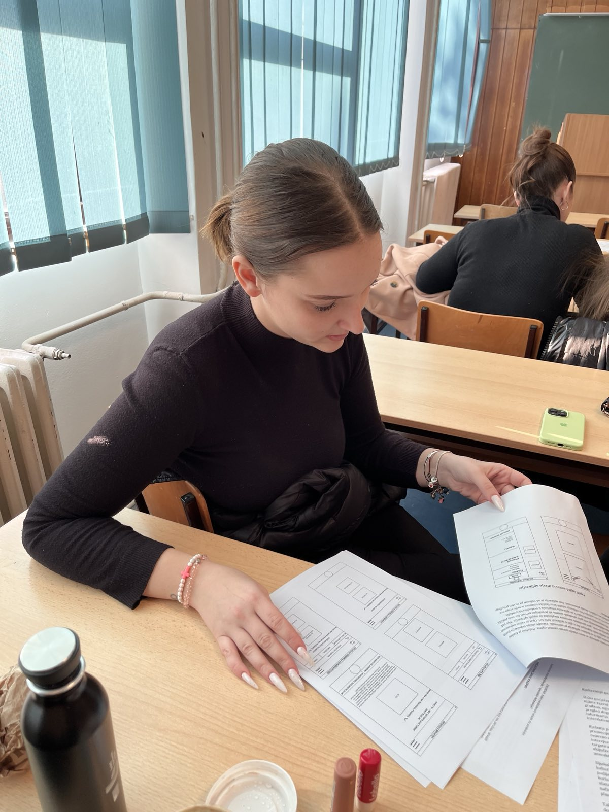
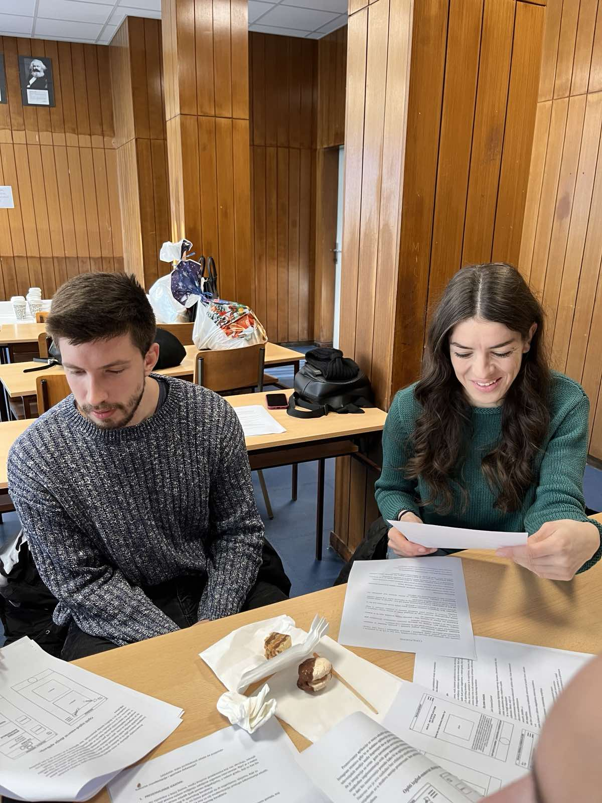
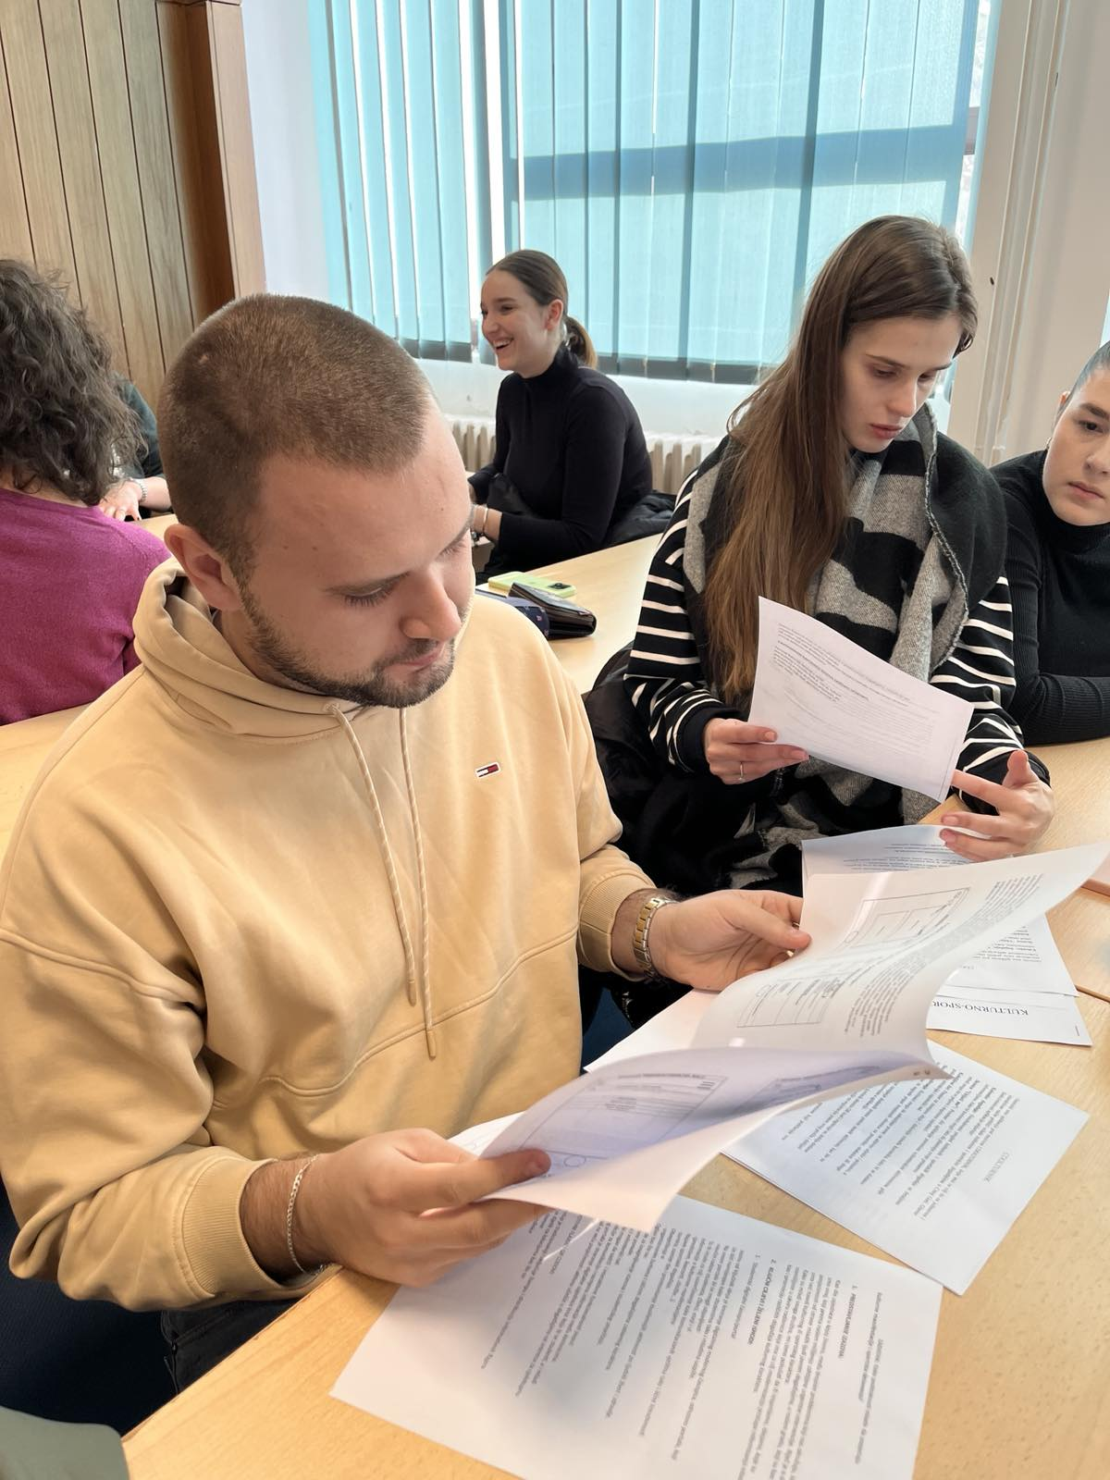
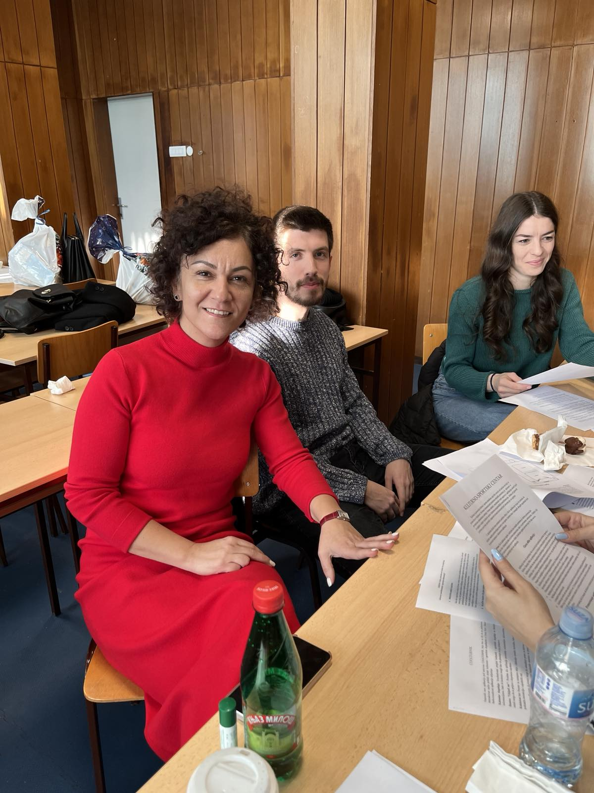
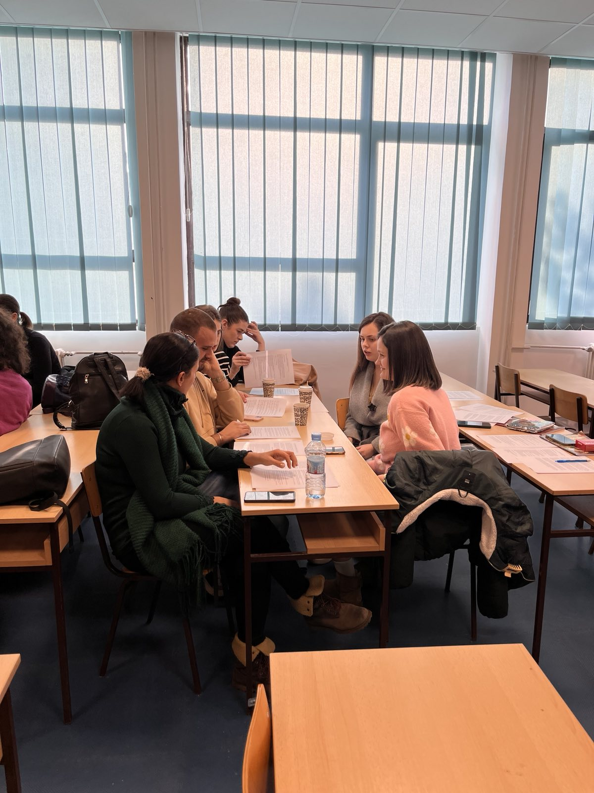
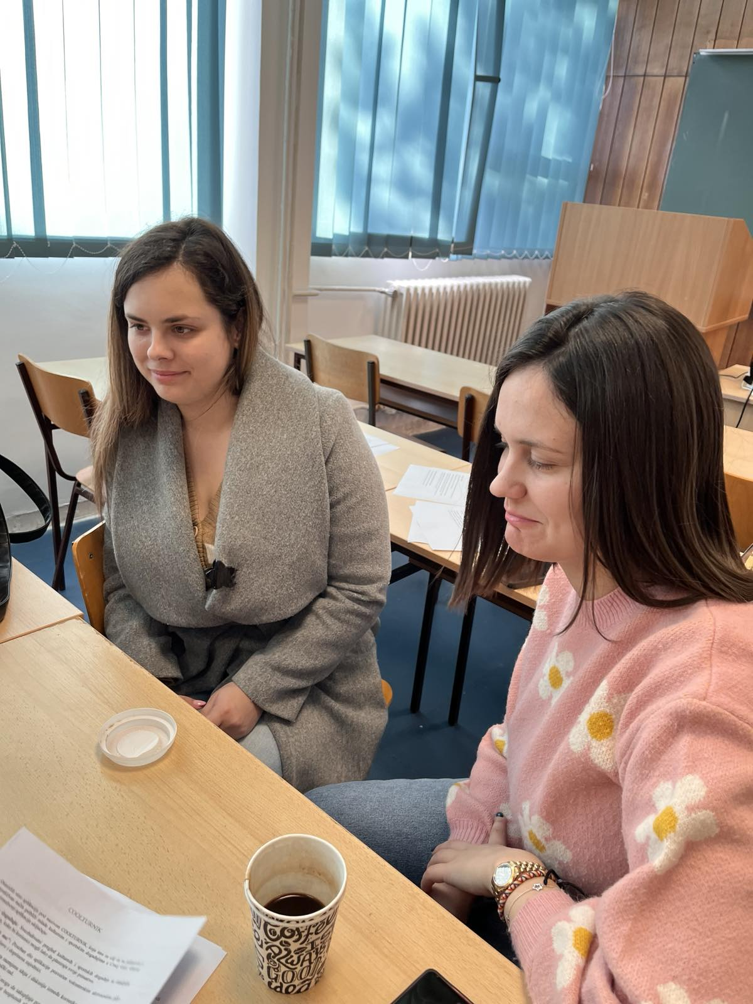
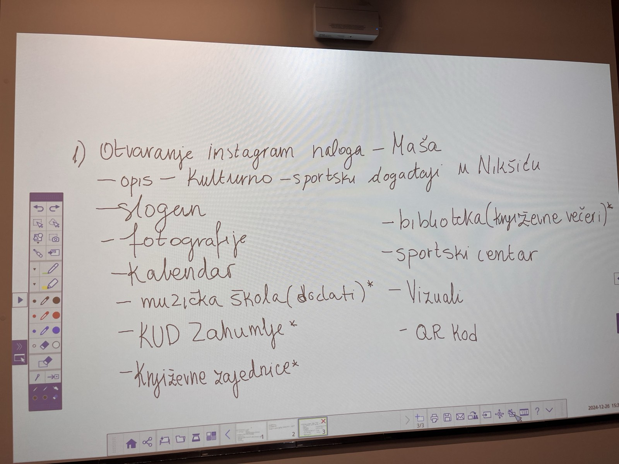
Team 2 – solution meeting

Slide 6
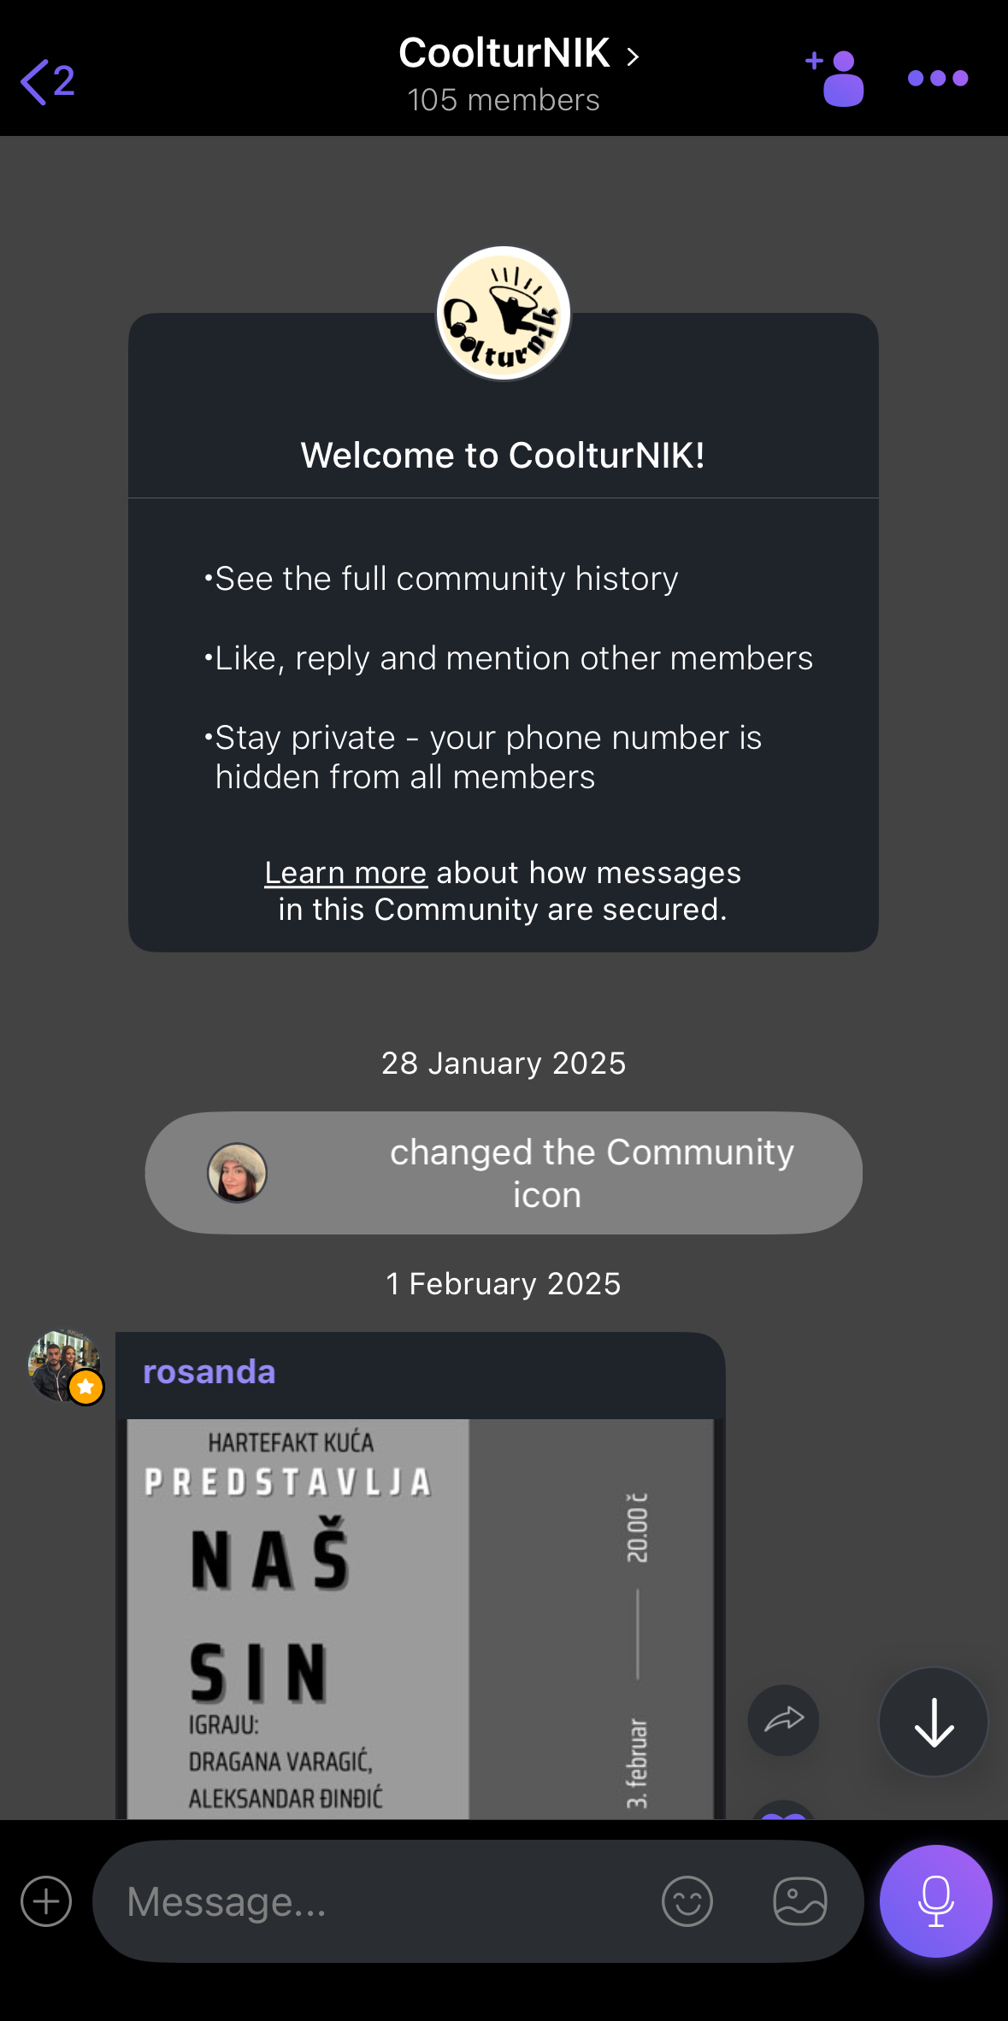
Solution - CoolturNIK

Slide 7
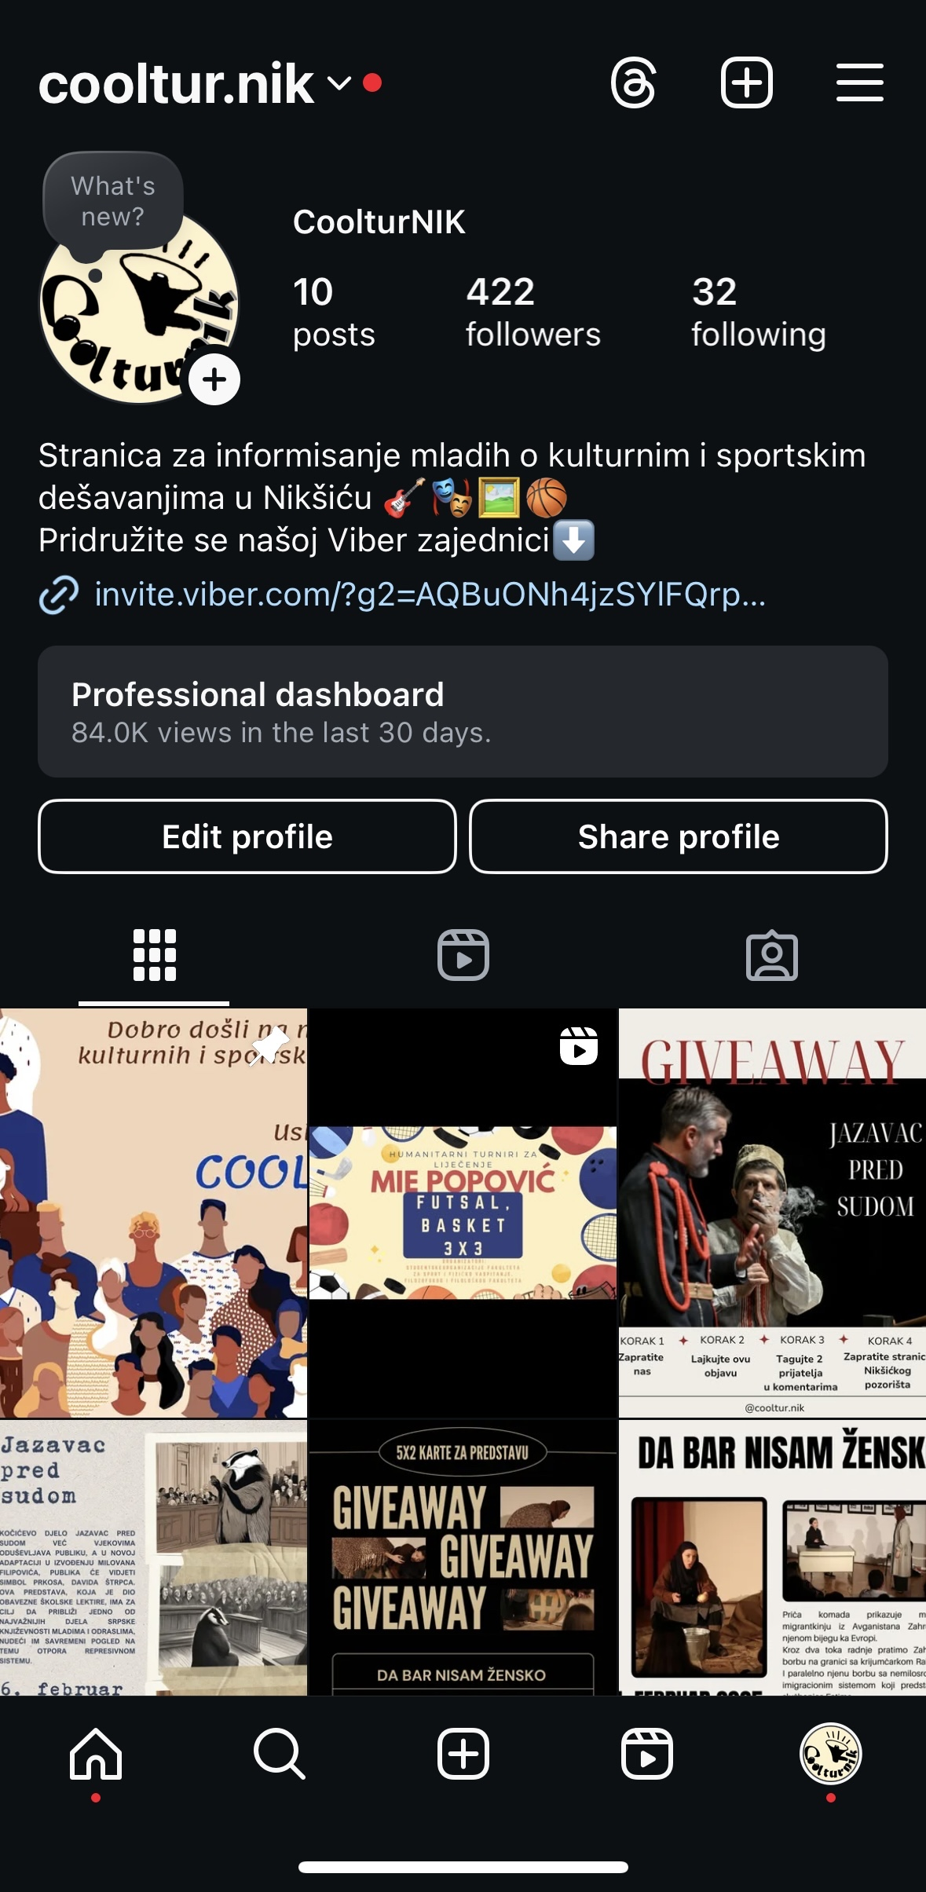
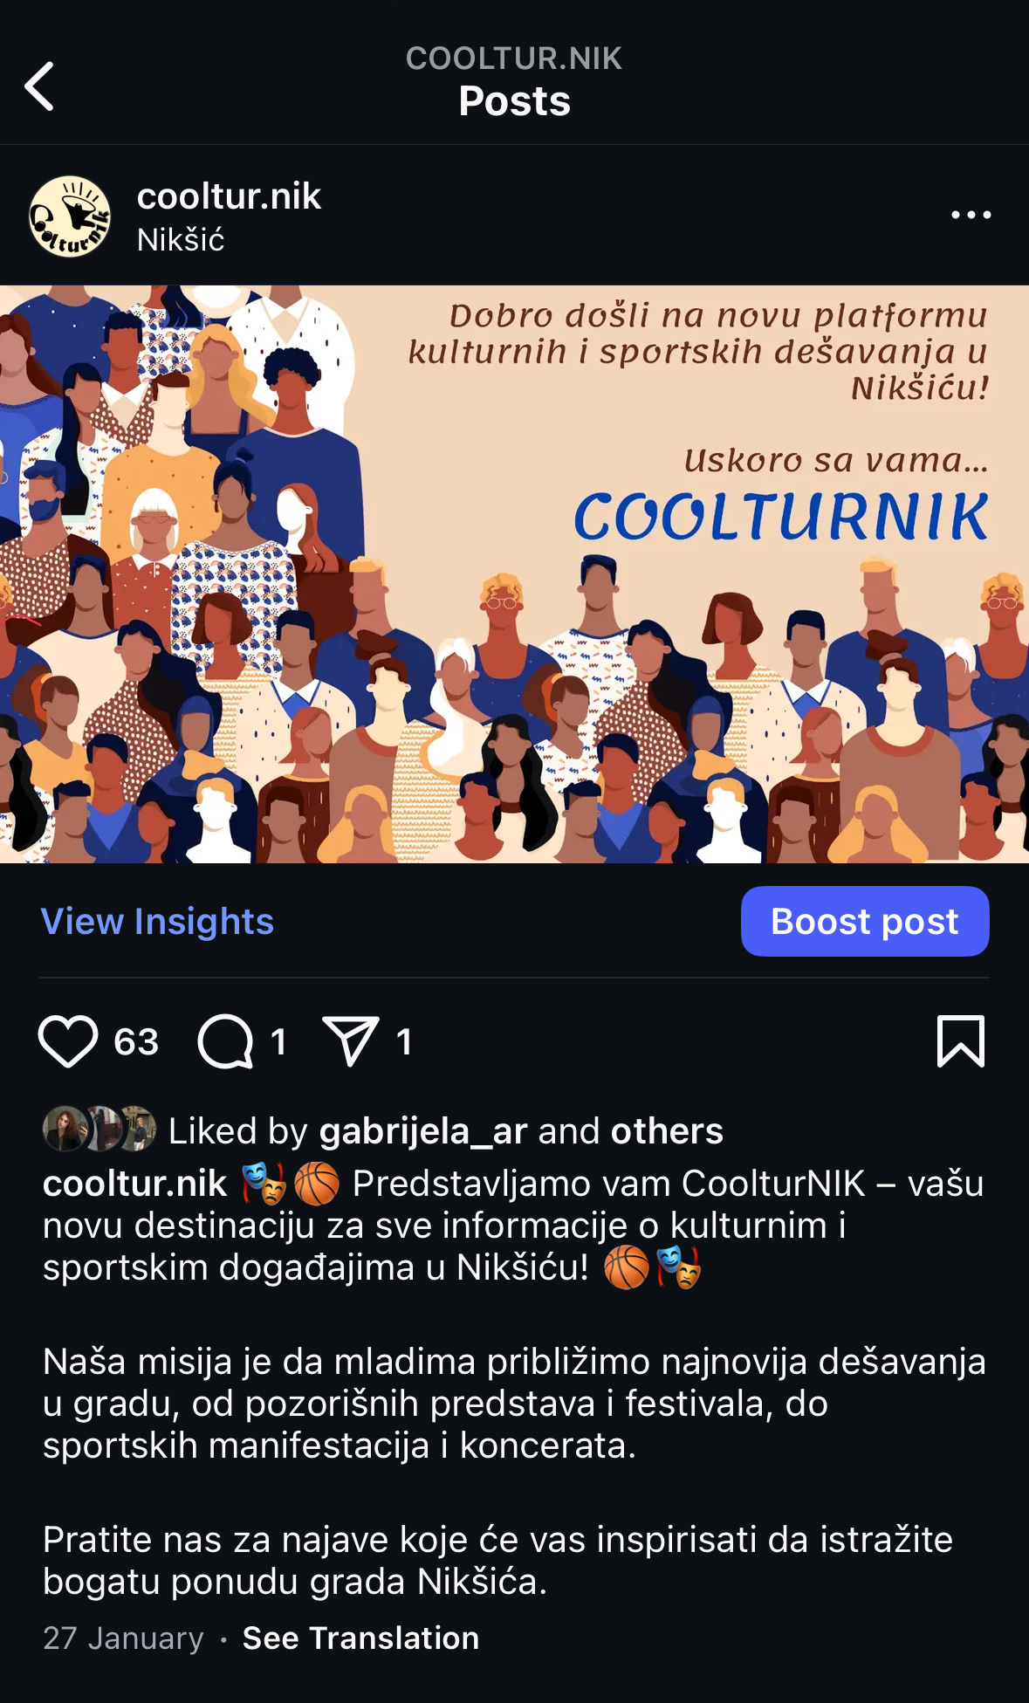
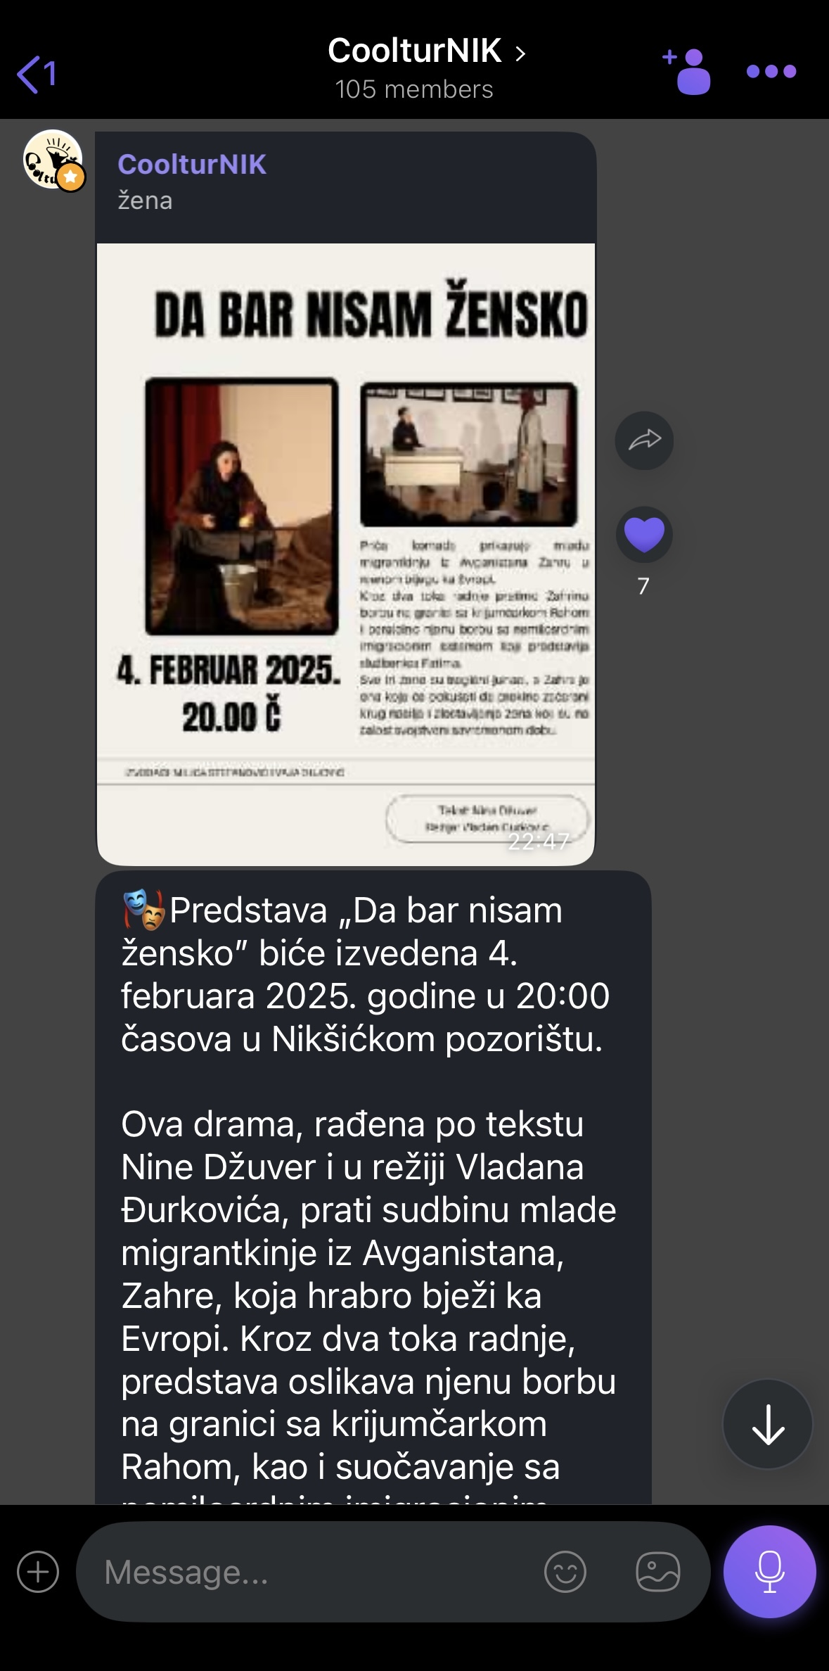
Solution - CoolturNIK

Slide 8
Partners:
Municipality of Nikšić
Theatre of Nikšić

Slide 9
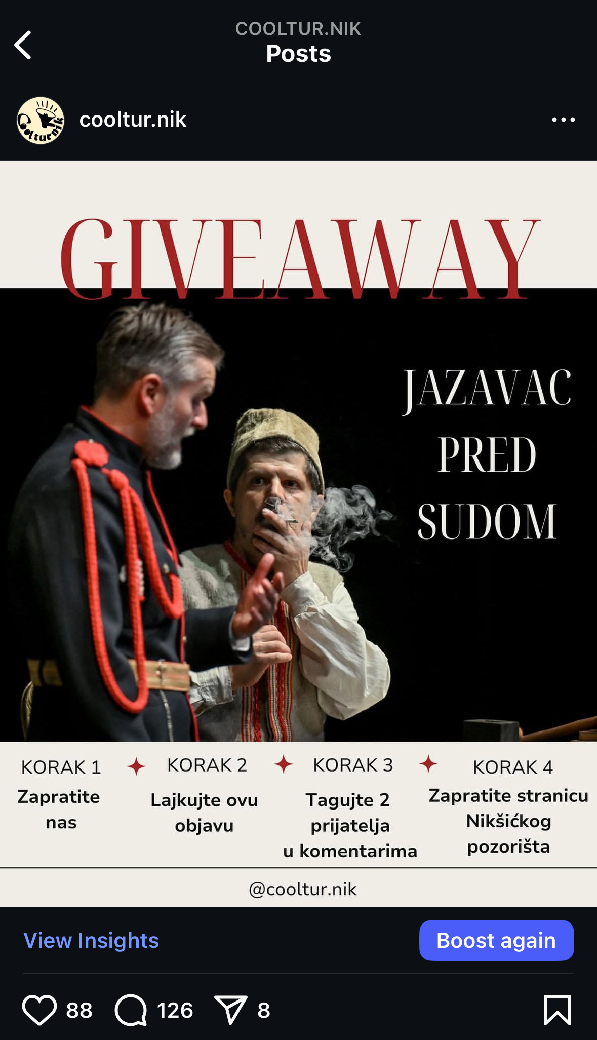
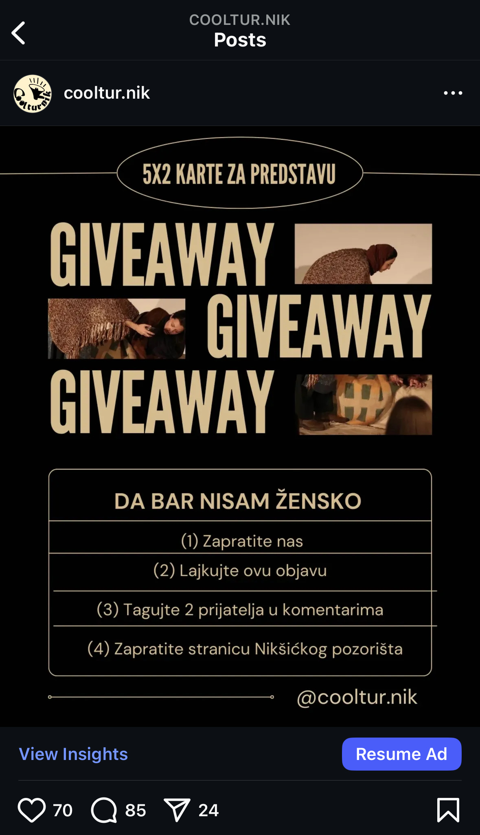
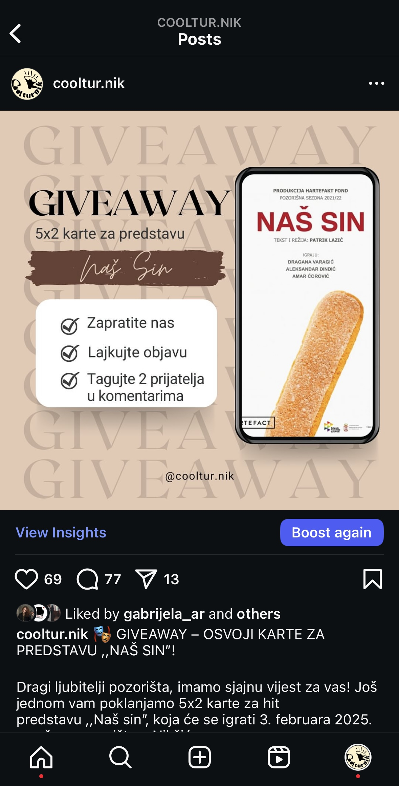
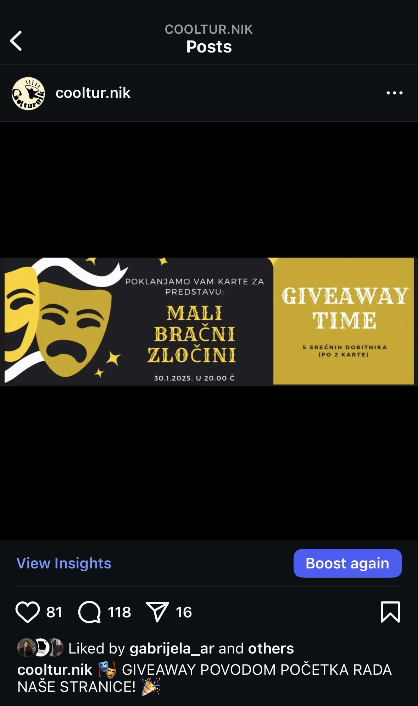
Ideas for promotion

Slide 10
Brochure

Slide 11
Results
1st play: 31%
2nd play: 20%
3rd play: 34%
4th play: 30%
of young people in the audience

Slide 12
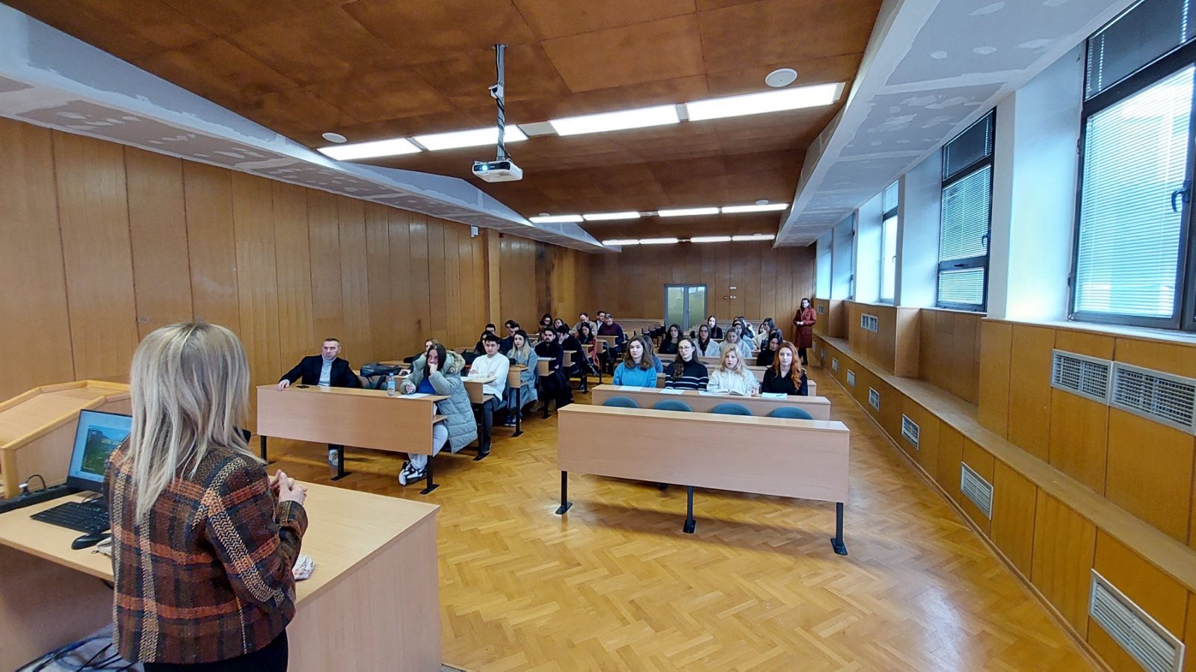
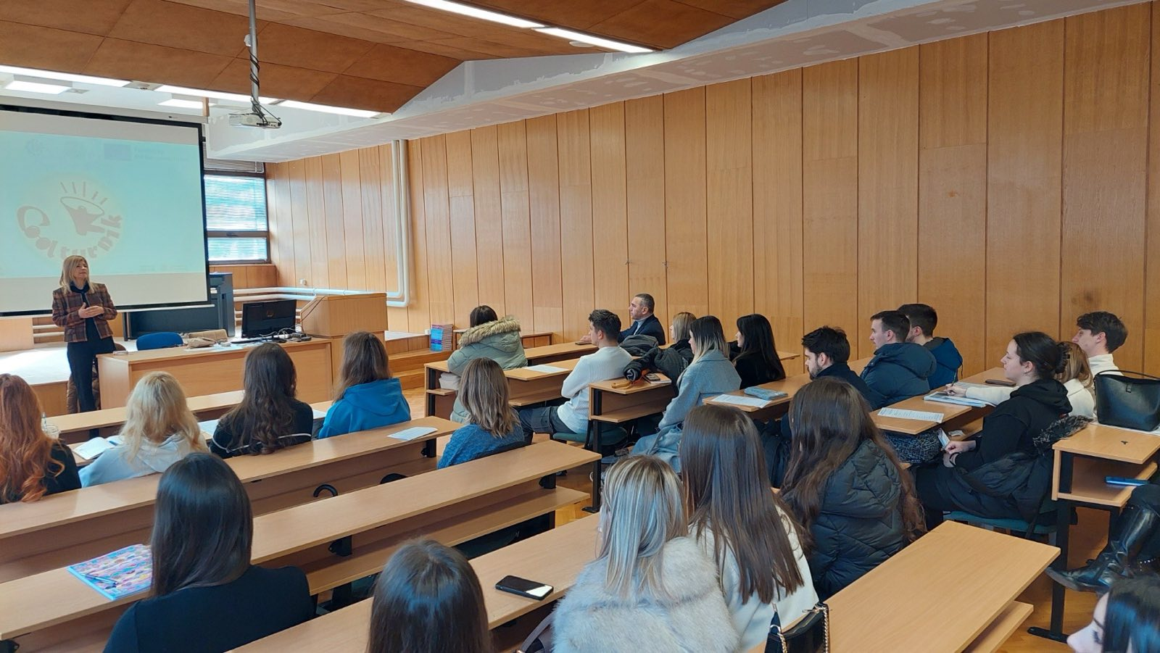
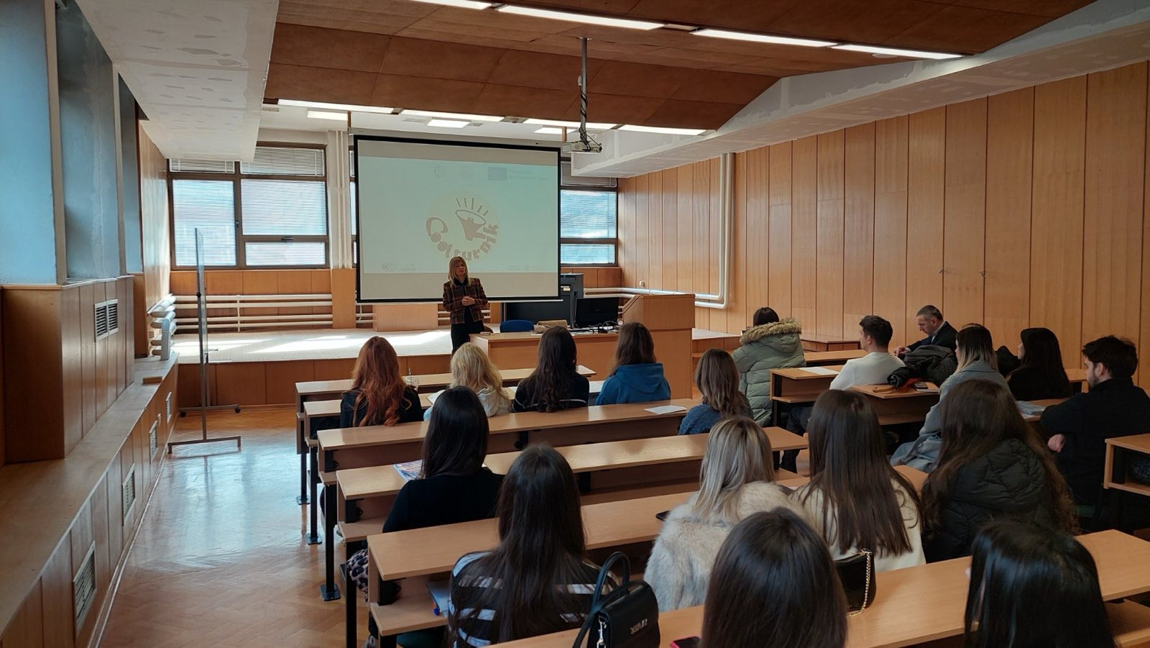
Presentation of results at the University of Montenegro

Slide 13
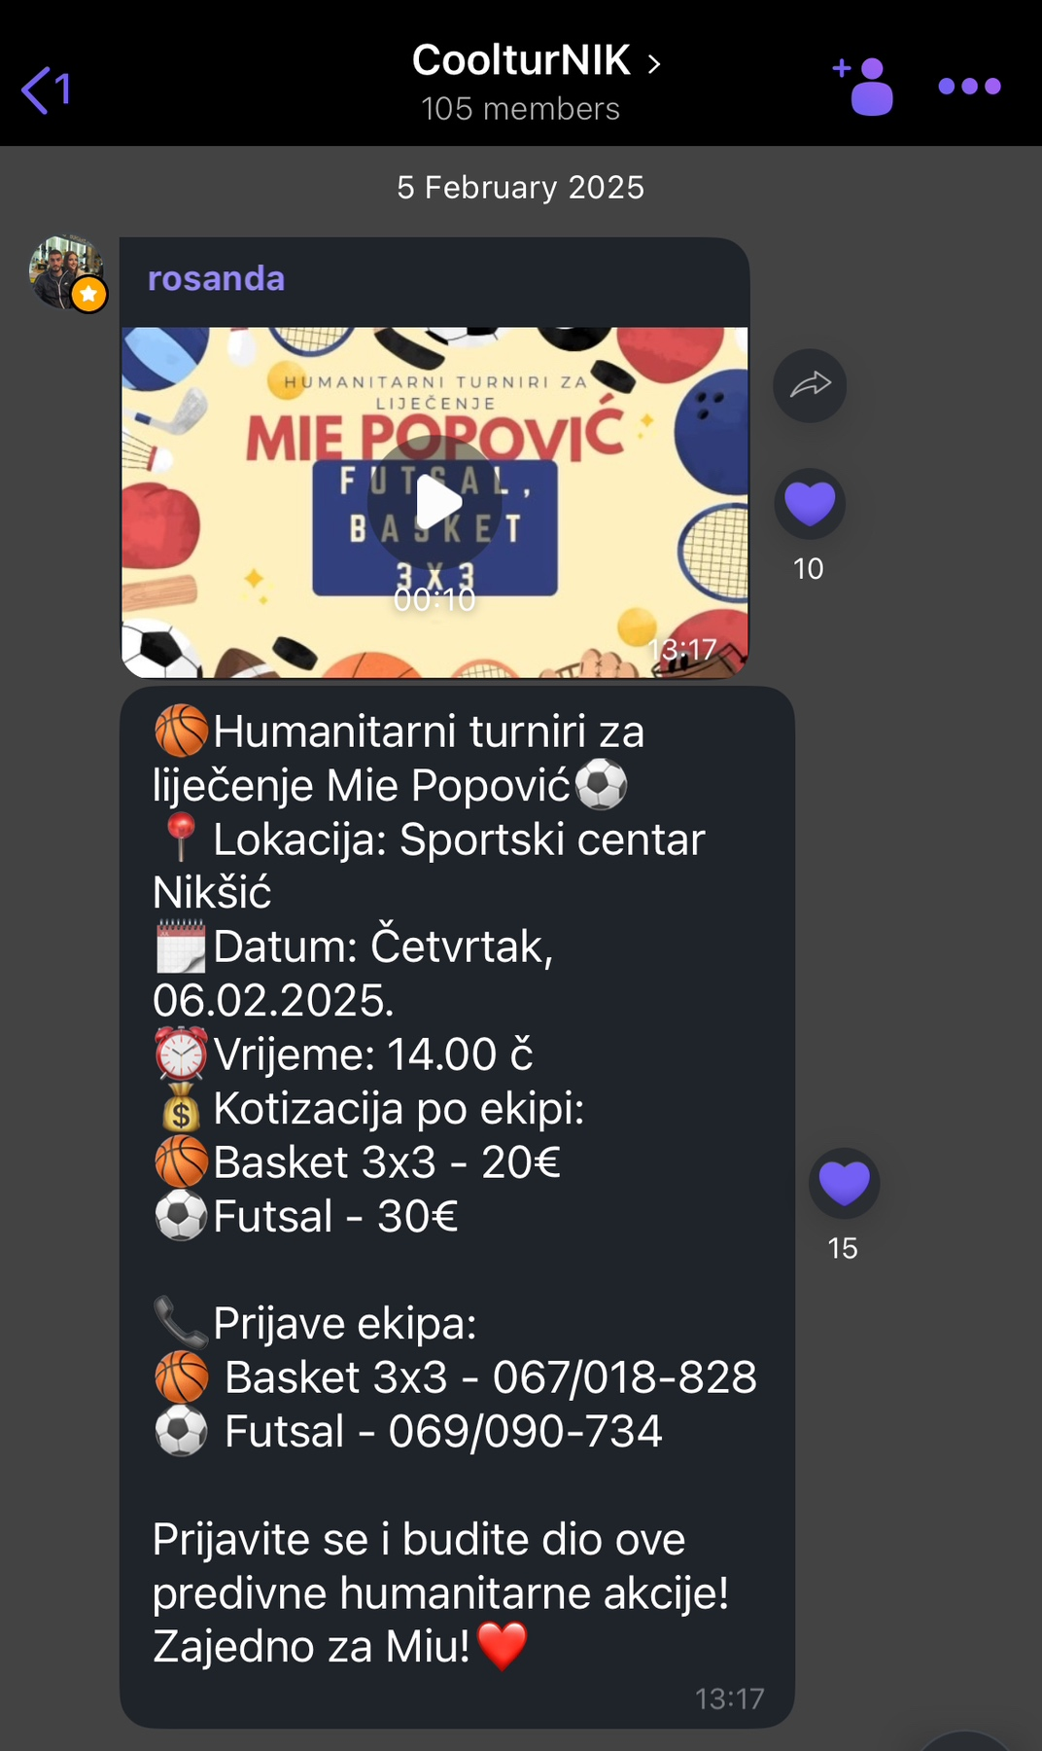
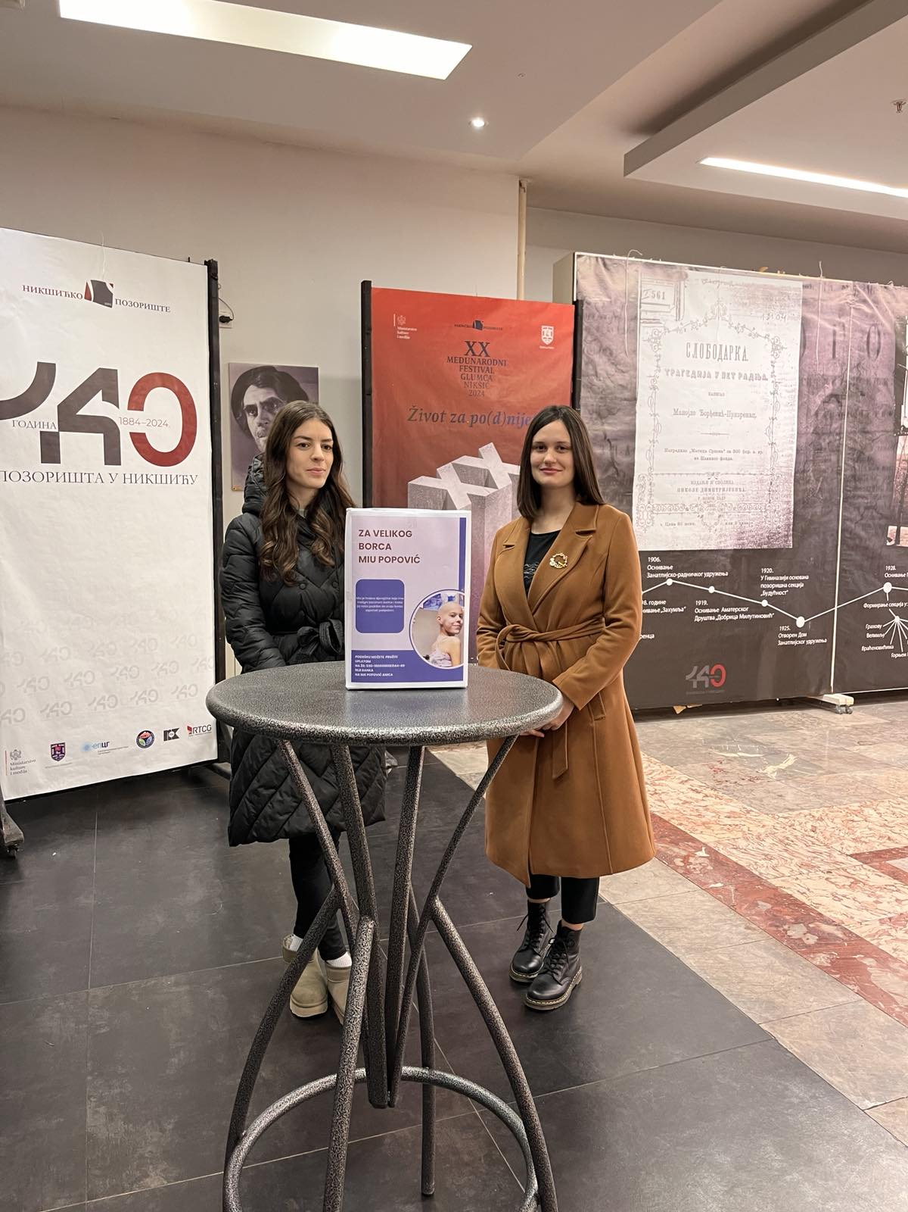
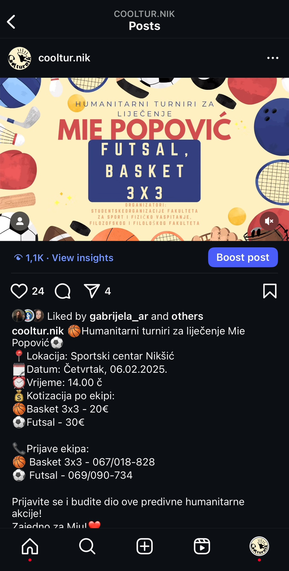
Humanitarian action for Mia

Slide 14
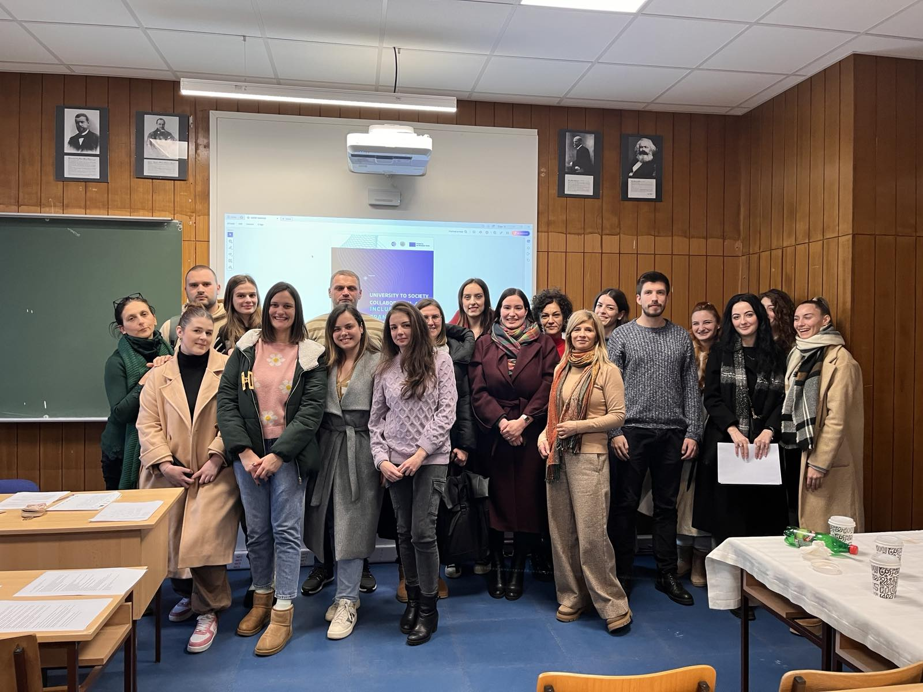
Thanks!

