Slide 1
Digital Transformation in Intercity and International Transportation: Challenges and Solutions
Mediterranean University of Albania

Slide 2
Introduction
The absence of digitization in Albanian public transport presents significant issues. Manual processes lead to inefficiencies, delays, and increased costs.

Slide 3
Problem Statement
Lack of a centralized digital platform for public transport in Albania results in poor accessibility, inefficiencies, and elevated operational expenses.
Company : Magus Group Albania

Slide 4
Objectives
1. Develop a centralized digital platform
2. Implement online booking and payment
3. Optimize operational resources
4. Enhance passenger experience

Slide 5
Methodology
Mixed-methods approach:
Qualitative: Interviews with stakeholders
Quantitative: Data on operational inefficiencies & satisfaction metrics

Slide 6
Proposed Solution
A centralized platform providing
Real-time route information
Online booking and payments
Fleet management tools

Slide 7
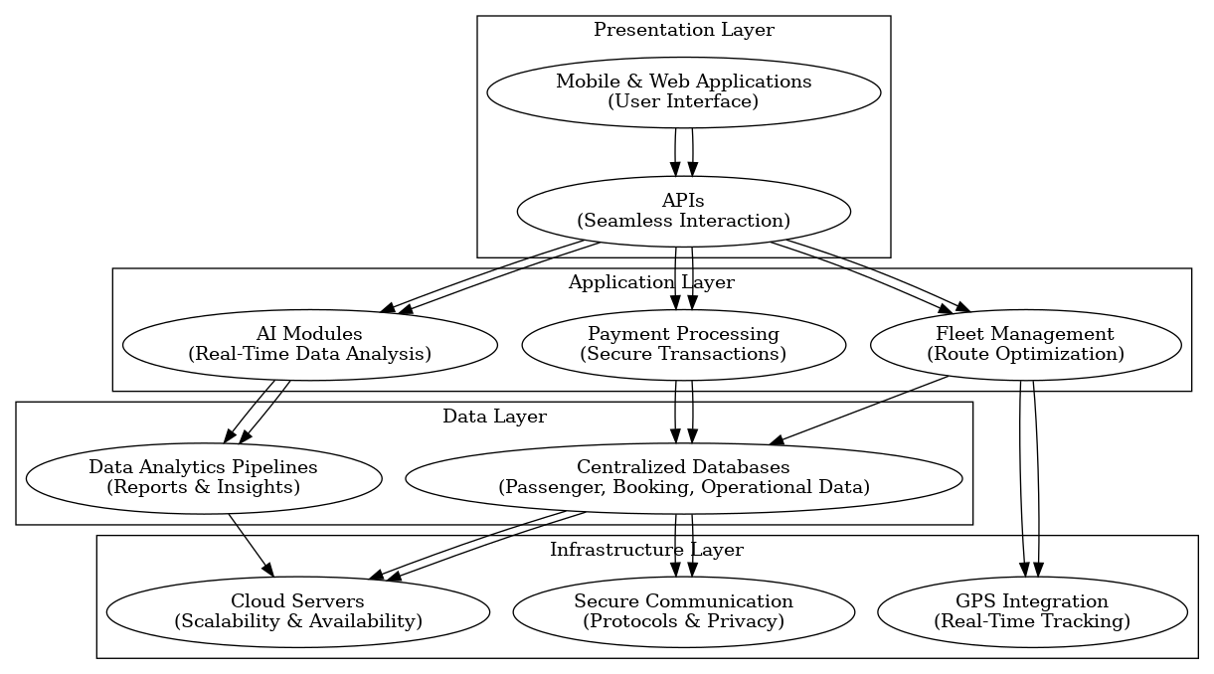
System Architecture I

Slide 8
System Architecture II
The Presentation Layer consists of mobile and web applications that feature an intuitive user interface, backed by APIs to ensure seamless interaction with backend services.
The Application Layer contains AI-driven components for real-time data analysis and demand forecasting, fleet management systems with optimized routing, and secure payment processing modules.
The Data Layer includes centralized databases for passenger, booking, and operational data storage, as well as analytics pipelines that produce insights and reports for operators.
The Infrastructure Layer fundamentally depends on cloud servers to ensure scalability and availability, integrates GPS for real-time vehicle tracking, and employs secure communication protocols to safeguard data integrity and privacy

Slide 9
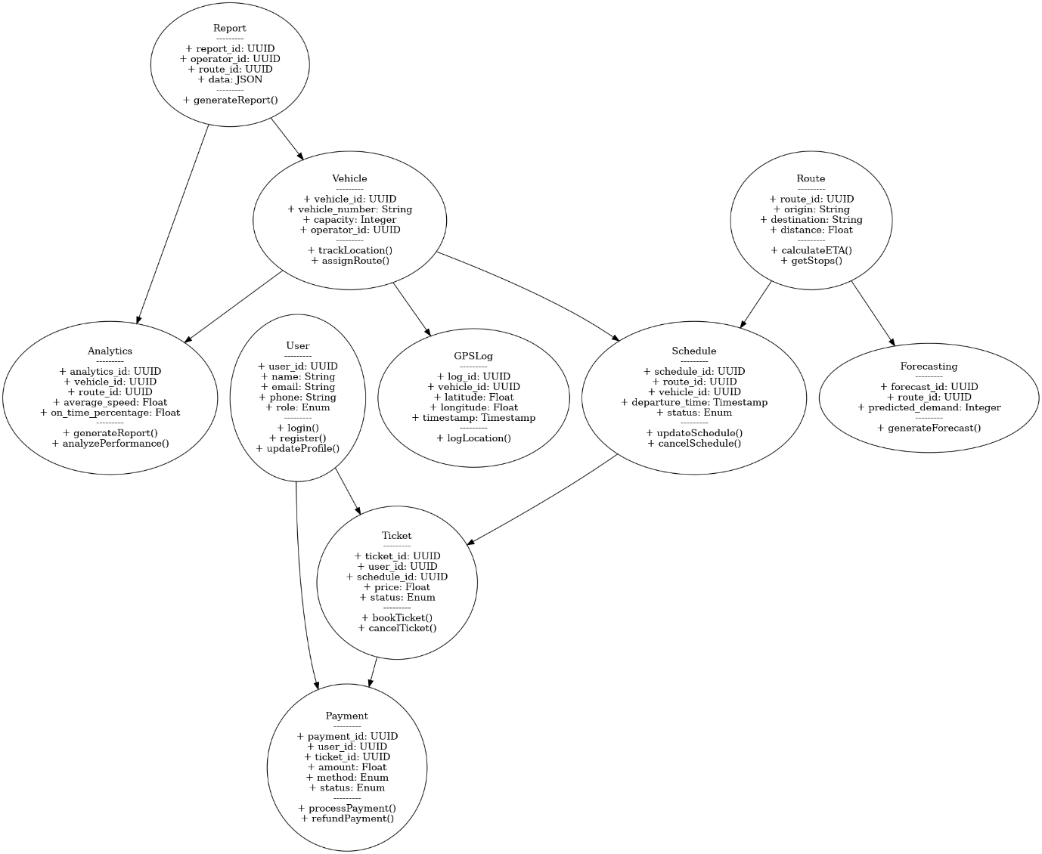
The UML Class Diagram I

Slide 10
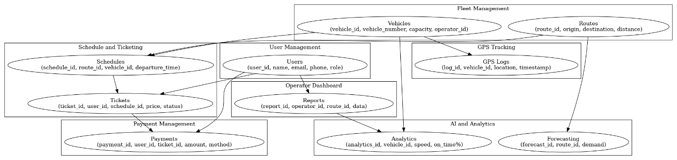
Prototype I

Slide 11
Prototype II
User Interface (UI):
A mobile and web application with intuitive navigation.
Real-time route and schedule updates displayed on a dynamic map.
Ticket purchasing options with multiple payment methods (credit card, digital wallets, etc.).
Backend Features:
AI-driven algorithms for demand forecasting and route optimization.
Integration of GPS tracking for real-time fleet monitoring.
Secure databases for managing passenger information and payment transactions.
Operator Dashboard:
Tools for transport operators to track fleet performance and manage schedules.
Reports and analytics to optimize operations and reduce costs.

Slide 12
CONCLUSIONS I
Impact Assessment
Operational Efficiency: Transport operators will benefit from streamlined processes, reduced costs, and better fleet utilization.
Enhanced Passenger Experience: Increased convenience, transparency, and reliability will attract more passengers.
Economic Growth: Improved transportation systems will boost connectivity and regional development.

Slide 13
CONCLUSIONS II
Recommendations
Government Support: Policies and funding are necessary to facilitate the development and implementation of the platform.
Pilot Programs: Testing the platform in select regions to identify and resolve potential challenges before full-scale deployment.
Stakeholder Collaboration: Engaging transport operators, passengers, and technology providers in the development process.

Slide 14
Future Work
AI Integration: Advanced predictive analytics for dynamic route optimization.
Scalability: Expanding the platform’s functionality to other sectors, such as logistics and urban transit.
Sustainability: Incorporating eco-friendly technologies to reduce the environmental impact of transport systems.

