Slide 1
Digital Transformation in Albania’s Tourism Sector
A Comprehensive Analysis of Challenges, Opportunities, and Strategic Solutions
U2SID – Erasmus+
Student : Iraklis Semanjaku
Mentors : Elion SHABANAJ & Jurgen MEÇAJ

Slide 2
Content
Introduction & Context
Methodology
Analysis of the Current State
Opportunities for Digital Transformation
Strategic Framework
Policy Implications & Recommendations
Case Studies
Conclusions

Slide 3
Introduction
Albania’s tourism sector is a key driver of economic growth.
The industry faces challenges in digital adoption and innovation.
This report explores solutions to transform the sector via digital tools and strategies.

Slide 4
Context of Tourism in Albania
Albania's cultural heritage and strategic location boost tourism.
Tourism contributes significantly to GDP and employment.
COVID-19 exposed vulnerabilities, highlighting the need for digital transformation.
According to World Bank data, in 2024, the tourism sector is expected to contribute significantly to Albania's economic growth, with a projected growth of 3.3%

Slide 5
Importance of Digital Transformation
Digital transformation in the tourism sector is not just a trend but an urgent need to remain competitive
It involves integrating digital technologies into all aspects of the tourism business, from marketing and sales to customer service and internal operations.
For Albania, this transformation presents a unique opportunity to overcome infrastructural gaps and position itself as an innovative and technology-friendly destination.

Slide 6
Study Objectives
1. What are the main challenges facing the Albanian tourism sector in adopting digital technologies?
2. How can digital transformation improve service quality, operational efficiency, and market competitiveness in the Albanian tourism sector?
3. What are the most effective strategies for implementing a successful digital transformation in the Albanian tourism industry?
4. How can digitalization contribute to the sustainable development of tourism and the preservation of Albania's cultural heritage?

Slide 7
METHODOLOGY
To address the study objectives and ensure a comprehensive analysis, this paper uses a mixed-methods approach:
Secondary Data Analysis:
Literature Review: An in-depth review of academic literature, industry reports, and previous studies on digital transformation in tourism.
Statistical Analysis: Review of statistical data from official sources such as INSTAT, World Bank, and World Tourism Organization (UNWTO) to understand current and historical trends in the Albanian tourism sector.

Slide 8
METHODOLOGY
Primary Data Collection
In-depth Interviews: Interviews with various stakeholders, including:
Tourism operators
Government agency representatives
Tourism industry experts
Information technology specialists

Slide 9
METHODOLOGY
Comparative Analysis
Case Studies: Analysis of best practices in digital transformation of tourism from similar countries or the region.
Benchmarking: Comparison of the performance of the Albanian tourism sector with neighboring countries and major European destinations in terms of digital technology adoption.

Slide 10
METHODOLOGY
Data Analysis
Quantitative Analysis: Use of statistical methods to analyze data collected from surveys and secondary sources.
Qualitative Analysis: Thematic coding of data from interviews to identify key themes and trends.
Validation of Findings
Data Triangulation: Comparison of findings from different sources to ensure the validity of results.
Expert Workshops: Organization of sessions with industry experts to validate preliminary findings and refine recommendations.

Slide 11
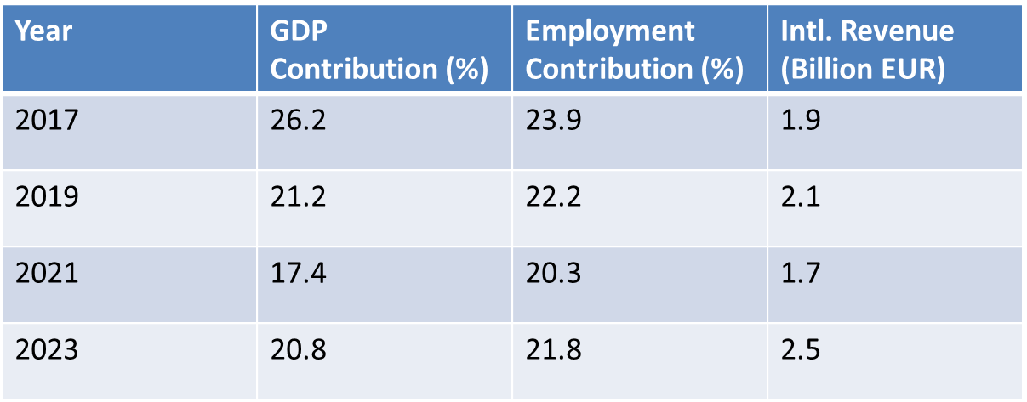
Tourism Contribution to GDP & Jobs

Slide 12
Tourism GDP & Employment Contribution

Slide 13
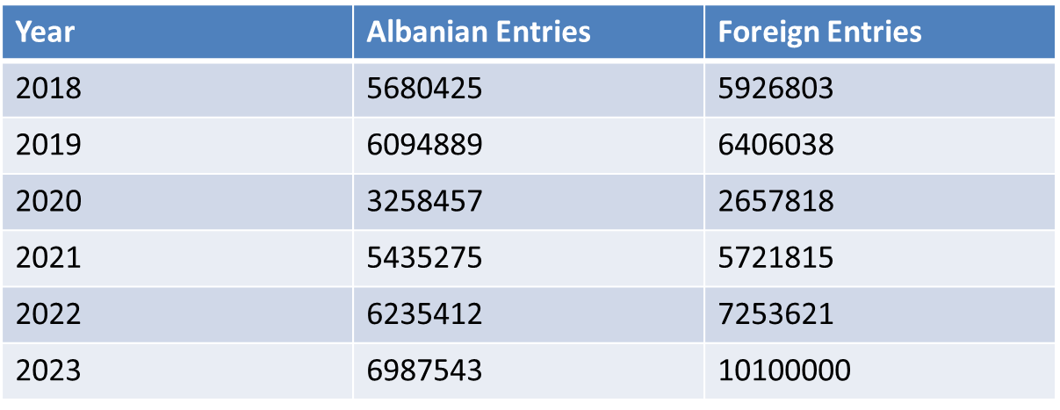
Tourist Movement (2018-2023)

Slide 14
Albanian vs Foreign Tourist Entries

Slide 15
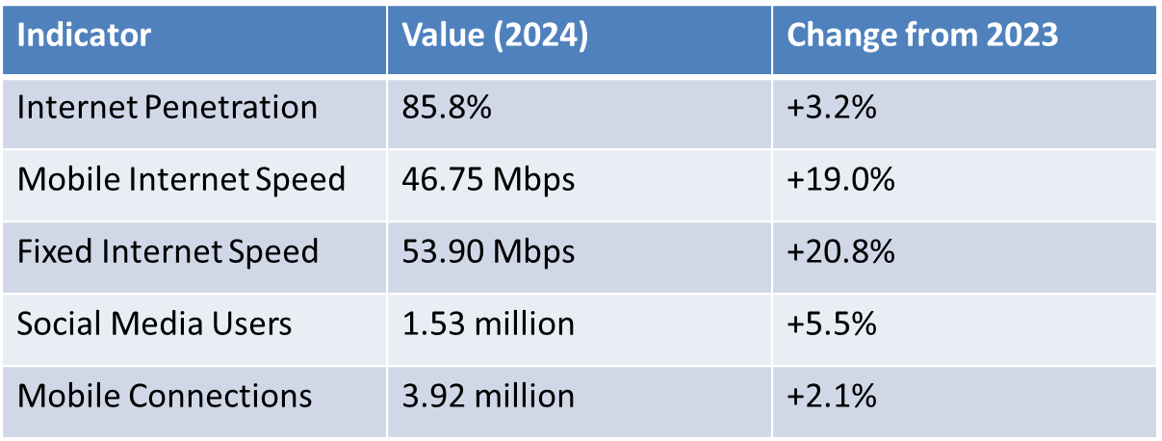
Digital Infrastructure Indicators in Albania

Slide 16
Key Challenges in Digital Transformation
Lack of Unified Digital Platform→Fragmented tourism data.
Limited Digital Skills→Need for specialized training.
High Costs→SMEs struggle with digital transformation costs
Rural Infrastructure Gaps→Poor internet access in remote areas.
Resistance to Change→Traditional businesses slow to adopt tech.

Slide 17
Opportunities for Digital Transformation
Unified Digital Platform → Centralized reservations and marketing.
Emerging Technologies → AI chatbots, VR/AR experiences, IoT monitoring.
Improved Digital Marketing → Social media, influencer campaigns, SEO.
Sustainable Tourism Tech → IoT for environmental monitoring.
Big Data & Analytics → AI-driven insights for personalized marketing.
Training Programs → Upskilling tourism professionals.

Slide 18
Strategic Framework
Vision: Position Albania as a digital tourism leader in the Balkans.
Strategic Objectives:
Enhance Efficiency: Automation, AI-driven processes.
Improve Visitor Experience: Personalization and digital services.
Increase Competitiveness: Advanced digital marketing.
Promote Sustainability: Eco-tourism through technology.
Foster Collaboration: Stakeholder engagement.

Slide 19
Implementation Plan
Phase 1: Foundation (Year 1)
Task force creation.
Needs assessment and pilot digital platform.
Initiate digital training programs.
Phase 2: Expansion (Years 2-3)
National rollout of digital platform.
Adoption of AI and IoT technologies.
Develop a comprehensive marketing

Slide 20
Policy Recommendations
1. Develop a National Digital Strategy
Align policies with digital goals.
2. Invest in Digital Infrastructure
Improve connectivity in tourist areas.
3. Support SMEs
Grants and incentives for tech adoption.
4. Strengthen Cybersecurity
Data protection standards.
Encourage Public-Private Collaboration
Joint digital projects.

Slide 21
Case Studies: Croatia & Greece
Croatia:
Launched Croatia.hr digital platform.
AI-powered tourist recommendations.
25% increase in online bookings.
Greece:
'Visit Greece' mobile app with real-time data.
Digital health tracking system during COVID-19.
40% increase in digital tourism engagement.

Slide 22
Conclusions
Digital transformation is crucial for Albania’s tourism growth.
A unified digital platform will improve efficiency.
Emerging technologies will enhance visitor experiences.
Policy alignment and investment are key to success.
Collaboration among stakeholders ensures long-term sustainability.

Slide 23
THANK YOU
Q&A

